Slide 1
SWIGGY (EDA)
1
Ruthik Kale
Gaurav Ghorpade

Slide 2

Agenda
Overall Market
Restaurant’s Distribution
High Ratings, Big Brains
Pricing Mirage
Popular Cuisines

Slide 3

Introduction
Swiggy is India's largest online food ordering and delivery platform, founded in 2014. Swiggy is based in Bangalore, India, and as of March 2019, was operating in 100 Indian cities.
In early 2019, Swiggy expanded into general product deliveries under the name Swiggy Stores.
In September 2019, Swiggy launched instant pickup/dropoff service Swiggy Go.
The service is used for a diverse array of items, including laundry and document or parcel deliveries to business clients and retail customers.
Swiggy is operated by Bundl Technologies Private Limited.
.

Slide 4
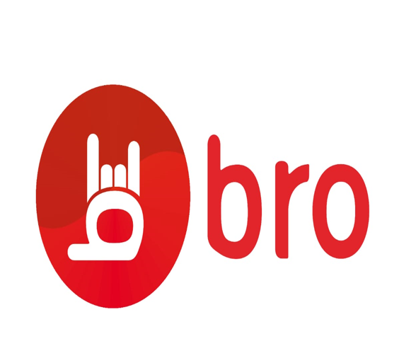
Overall Market
4
~Current Growth

Slide 5
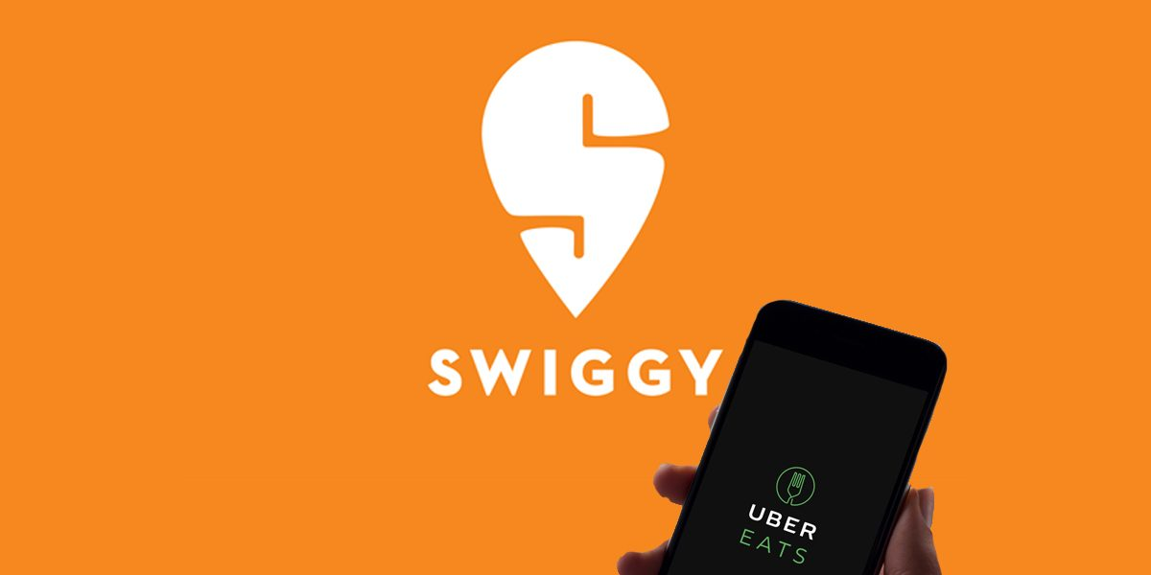
Current Growth

Slide 6
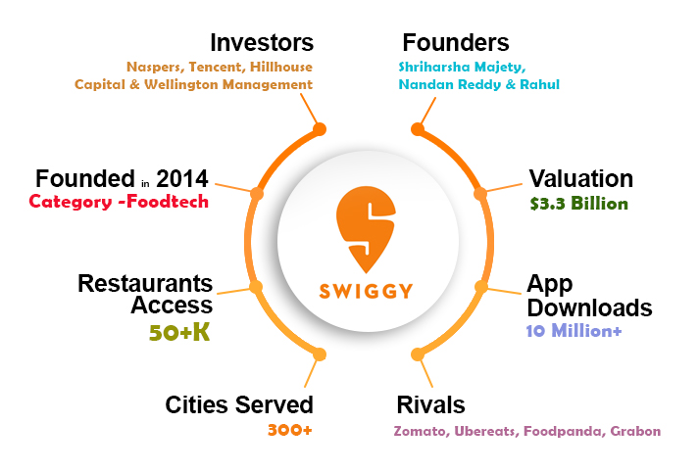

Small Intro

Slide 7

7
Started with Delivering all kinds of parcels,
Also with Pick and Drop services.

Slide 8
Restaurants distribution
8

Slide 9
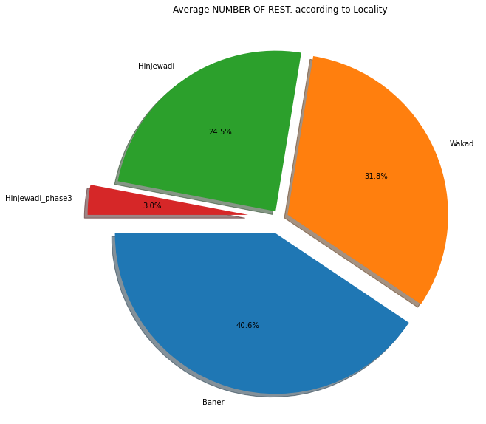
Number Of Restaurant's
HINJEAWADI
286
HINJEWADI PHASE 3
35
WAKAD
371
473
BANER

Slide 10

Restaurants distribution according to Locality…
Restaurants located in Bavdhan and Balewadi are combined in Baner.
Hinjewadi locality is divided in two sections : Hinjewadi
Hinjewadi Phase 3

Slide 11
High ratings big brains
11

Slide 12
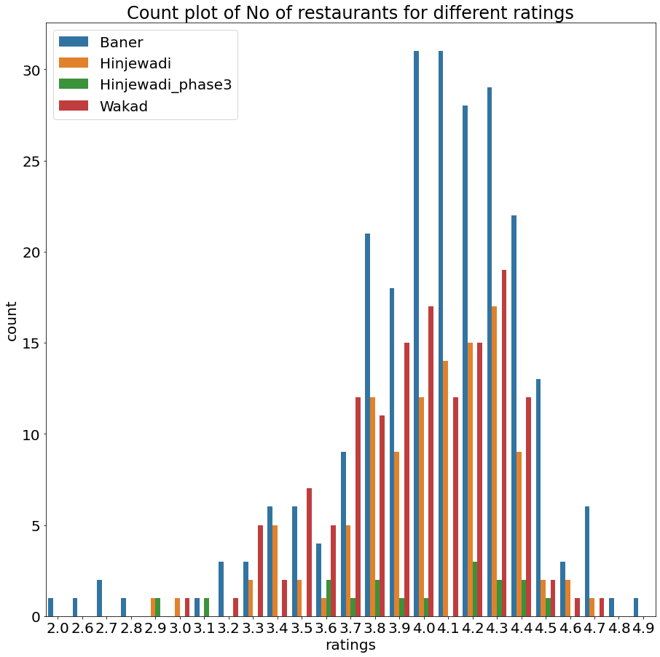
Pumped Ratings
The average rating is 4.03
Most restaurants are rated between
3 to 5.
Baner has most number of
Top rated restaurants (about “163”)
Followed by Hinjewadi (“82”)
Wakad (“80”)

Slide 13
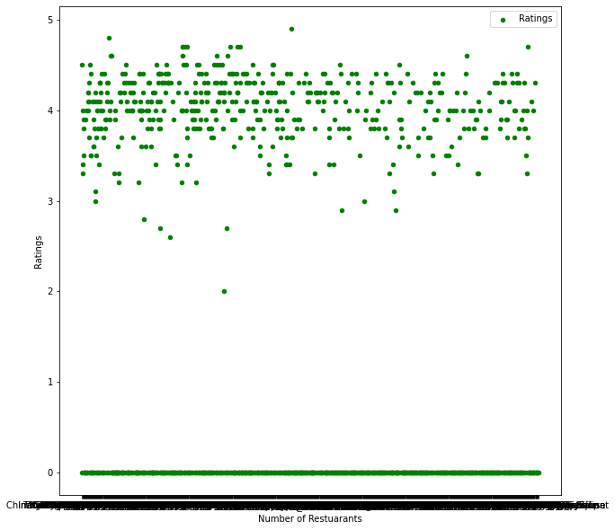
Insights :
Approx. 700 restaurant's are not rated on this Application.
The remaining 1000 – 900 restaurant's are rated between 3 – 5
It may not be possible for all 1000 restaurant's to maintain their ratings above 3
So the ratings process should be handled by Swiggy itself, and cant be complete true.

Slide 14
Pricing mirage
14

Slide 15
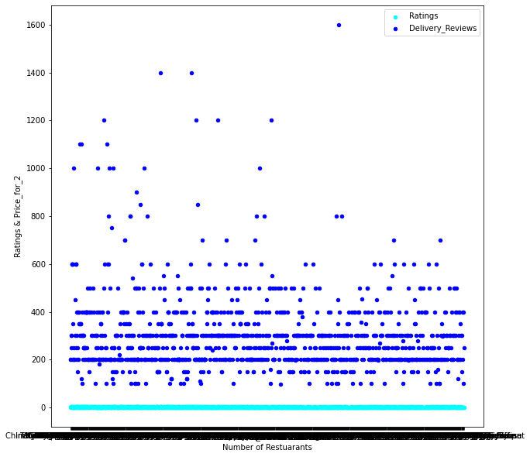
Average Pricing for two
Insights:
Average pricing for two is 250/-
Most restaurant's have their price range between 200 – 600
Very few restaurants are priced above 1000 / 1200

Slide 16
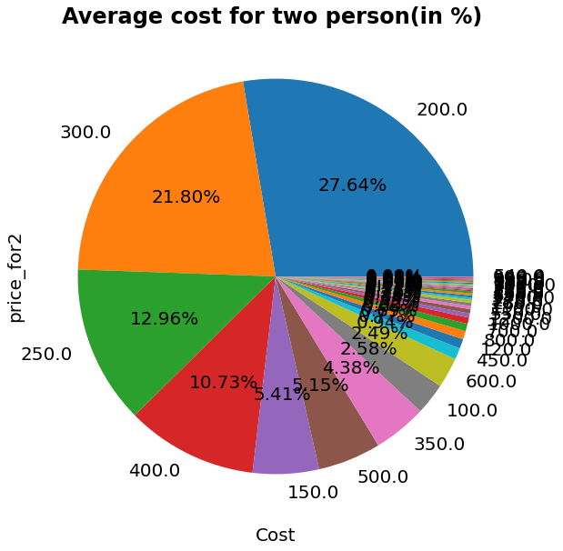
Price For Two
322 restaurants have 200/- pricing for two
322 Restaurant's
254 Restaurant's
151 Restaurant's
125 Restaurant's
200/-
300/-
250/-
400/-

Slide 17
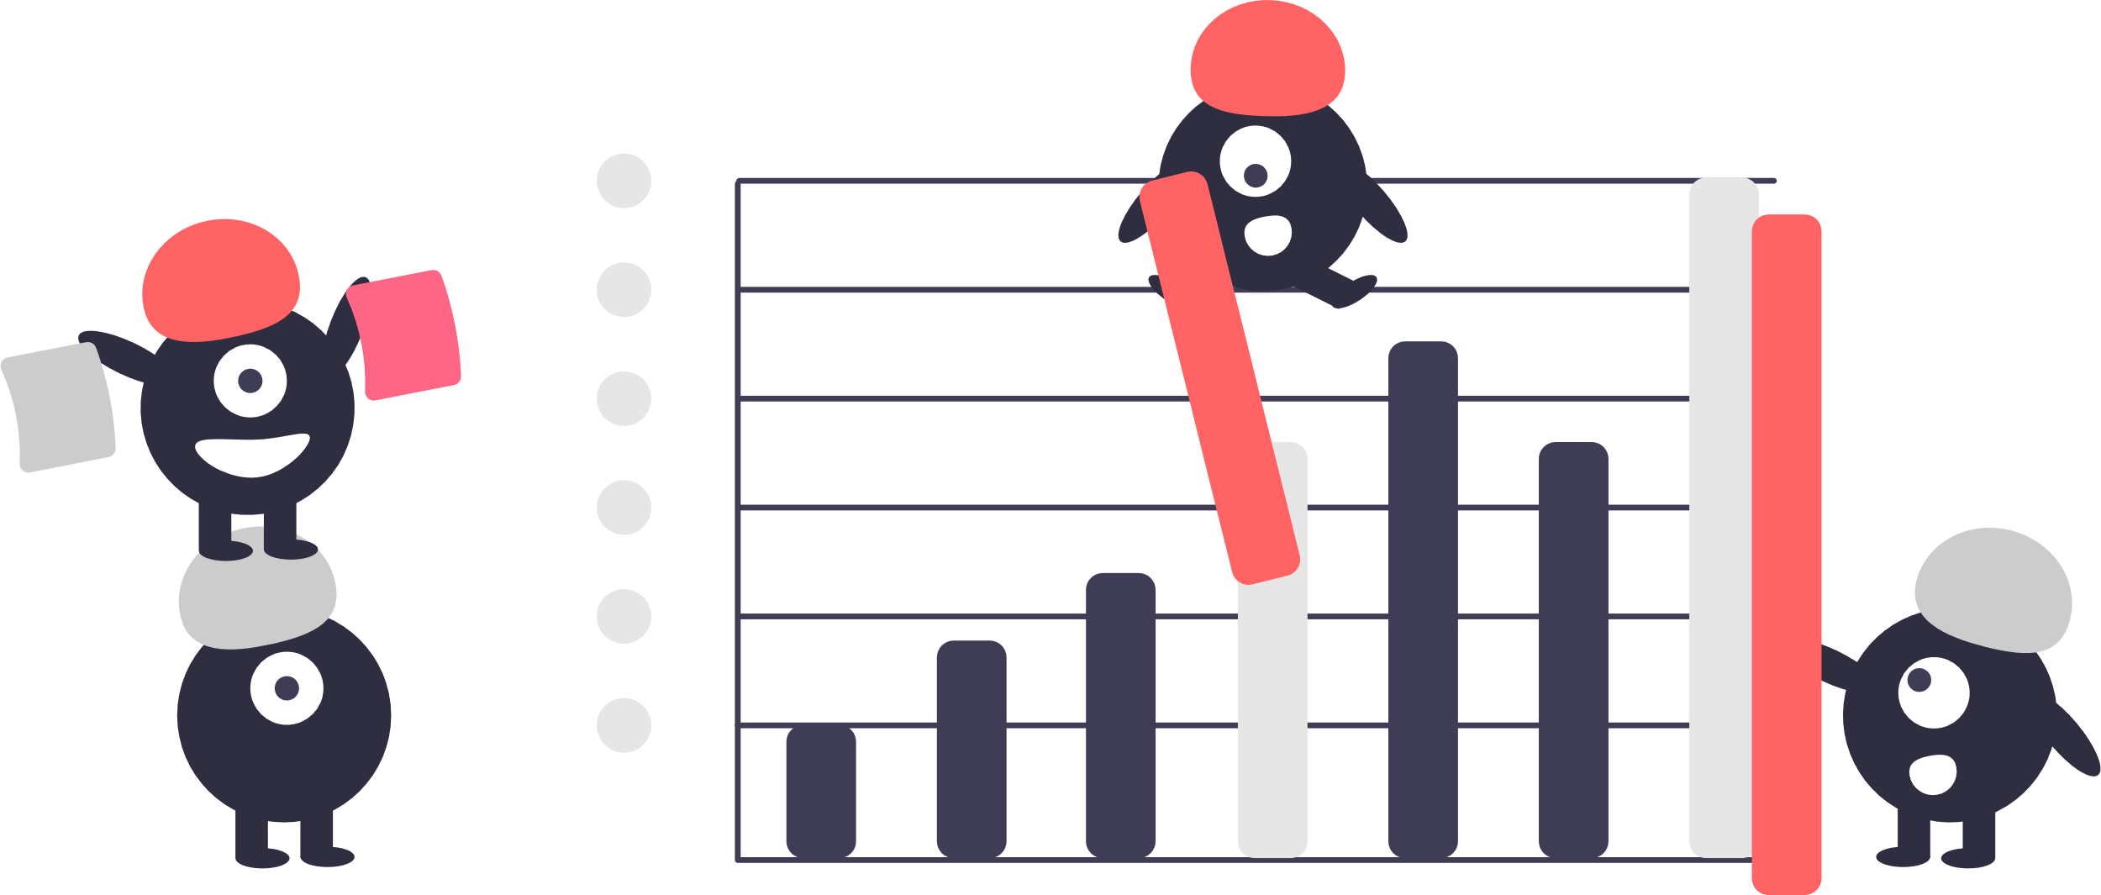
Logic Behind Low Pricing…
The pricing of all restaurants are listed low on this application, as compared to the original price when calculated.
The App shows the approximate pricing for two people, but in reality it is much more than the pricing for one person().
Example: Eagle boys (price_for_2 = 250/-)
7” pizza listed for = (150 to 360)
10” pizza listed for = (240 to 490)
The application shows the lowest
approximate price for two…

Slide 18
Popular cuisines
18

Slide 19
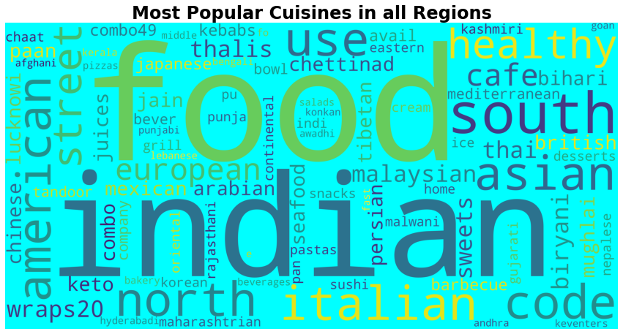
Most popular Cuisines…

Slide 20
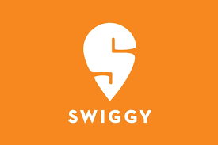
Summary
From the Data collected from the official website of Swiggy, it was observed that,
Swiggy has included Bavdhan, Balewadi and Baner all under one locality.
Most number of Restaurants are rated between 3 to 5, and an average of 4.03
Most Restaurants have displayed low pricing to attract customers.

Slide 21



Thank you
Ruthik Kale
Gaurav Ghorpade
ruthikkale27@gmail.com

